Slide 1
Plasma Diagnostic Techniques Lecture 12: Thomson scattering
Deborah O’Connell
York Plasma Institute

Slide 2
Thomson Scattering

Slide 3
Laser Light Scattering
Plasma
YAG:Nd Laser @ 532 nm
Free electrons → Thomson scattering
Bound electrons → Rayleigh scattering
Scattering by molecules → Raman Scattering

Slide 4
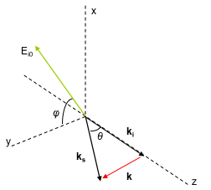



Thomson scattering
If an electron is moving with velocity v in the direction of the incident light wave (wavevector k₀) then, in our classical view, the electron oscillates at:
The scattered light is Doppler shifted and appears to the observer at:
Scattering geometry
Leading to:
Notes:
2 Doppler effects occurring:
- Incoming light and moving electron
Accelerated electron and the observer
Wavevector = 2pi/lambda
(only sees component in direction of the laser)
wd – frequency the electron ‘sees’
S - in direction of the observer
Ki (incoming wave)
Ks (scattered wave),

Slide 5
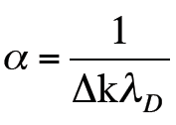
Scattering parameter
Scattering parameter:
The observation angle allows us to ‘tune’ between incoherent and coherent scattering regimes. Often the incoherent regime is preferred because of its ‘simplicity’, i.e. 90° observation, which also reduces unwanted stray light.
2π/Δk
2π/Δk
→ Incoherent scattering: Electron contributions dominate the scattered spectrum (typical for low plasma densities)
→ Coherent scattering: Ion contributions modify the scattered spectrum (typical for high plasma densities)
Notes:
If scattering is small compared to Debye length – collective behaviours don‘t play a role – only see electrons (probing individual electrons)
Scattering parameter comparable to Debye length – see collective phenomena – ions and electrons interact on that lengthscale
High densities – small Debye length
Delta k depends on – direction (observer position relative to incident laser) and laser wavelength.
Little tuning range using these – limited.

Slide 6
1. Intensity of scattered light => electron density
2. Spectral distribution of scattered light => electron temperature (EEVF) (Doppler-effect turns velocity distribution into spectral distribution, width of the distribution gives electron temperature)

Slide 7
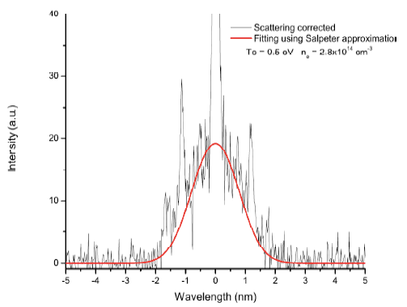
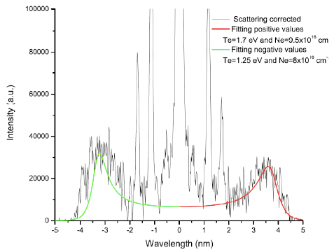
Scattering regimes
Incoherent scattering:
Coherent scattering:

Slide 8
Thomson scattering on MAST

Slide 9
Thomson scattering on MAST

Slide 10
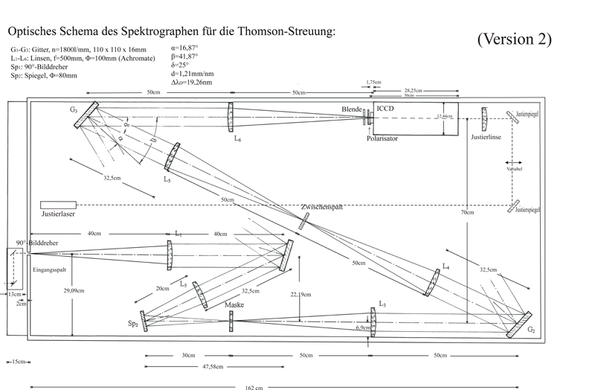
Practical challenges
Thomson scattering cross section is very small requiring high power lasers.
Stray light can be problematic, using a triple grating spectrometer can very efficiently reduce stray light.

